Slide 1
Foretold
2024 Quarter 4 Lesson 8
John 18, 19, 20

Slide 2
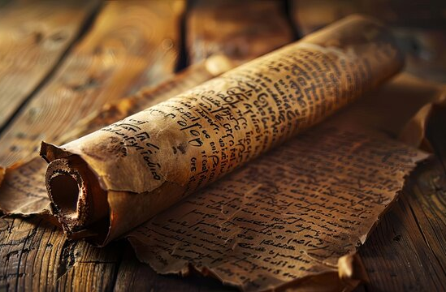
Scripture Fulfilled
OT Prophecy plainly revealed Jesus as the Messiah.

Slide 3
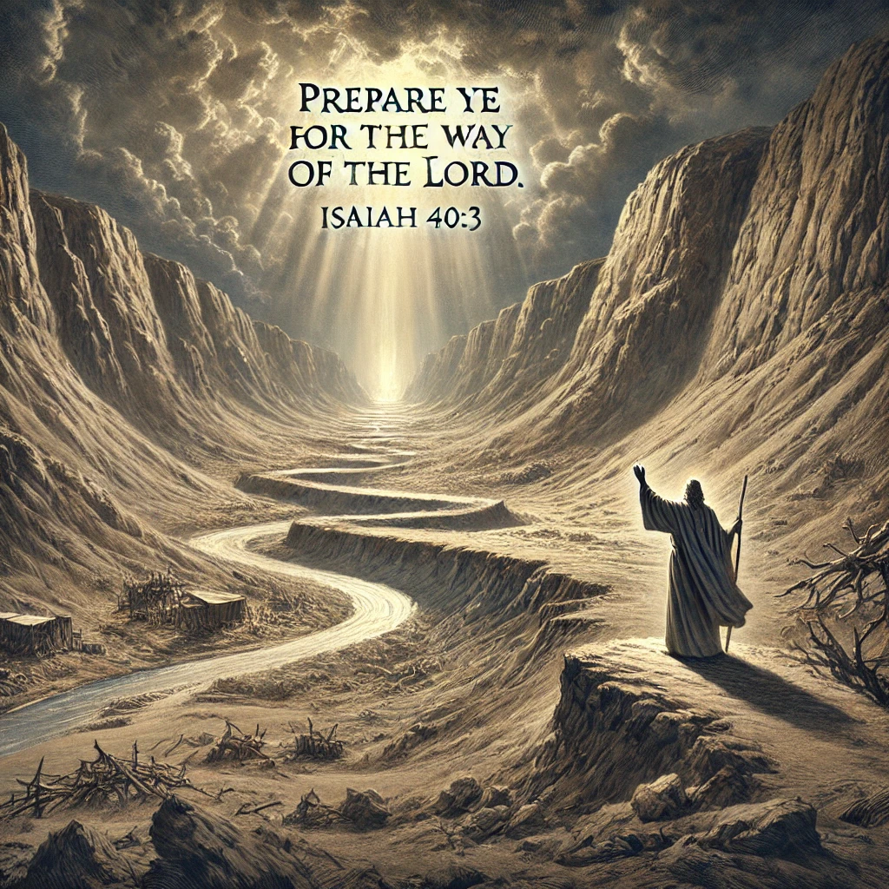
Prophecy Fulfilled
Isaiah 40:3
John 1:23
³ The voice of him that crieth in the wilderness, Prepare ye the way of the Lord, make straight in the desert a highway for our God.
²³ He said, I am the voice of one crying in the wilderness, Make straight the way of the Lord, as said the prophet Esaias.

Slide 4
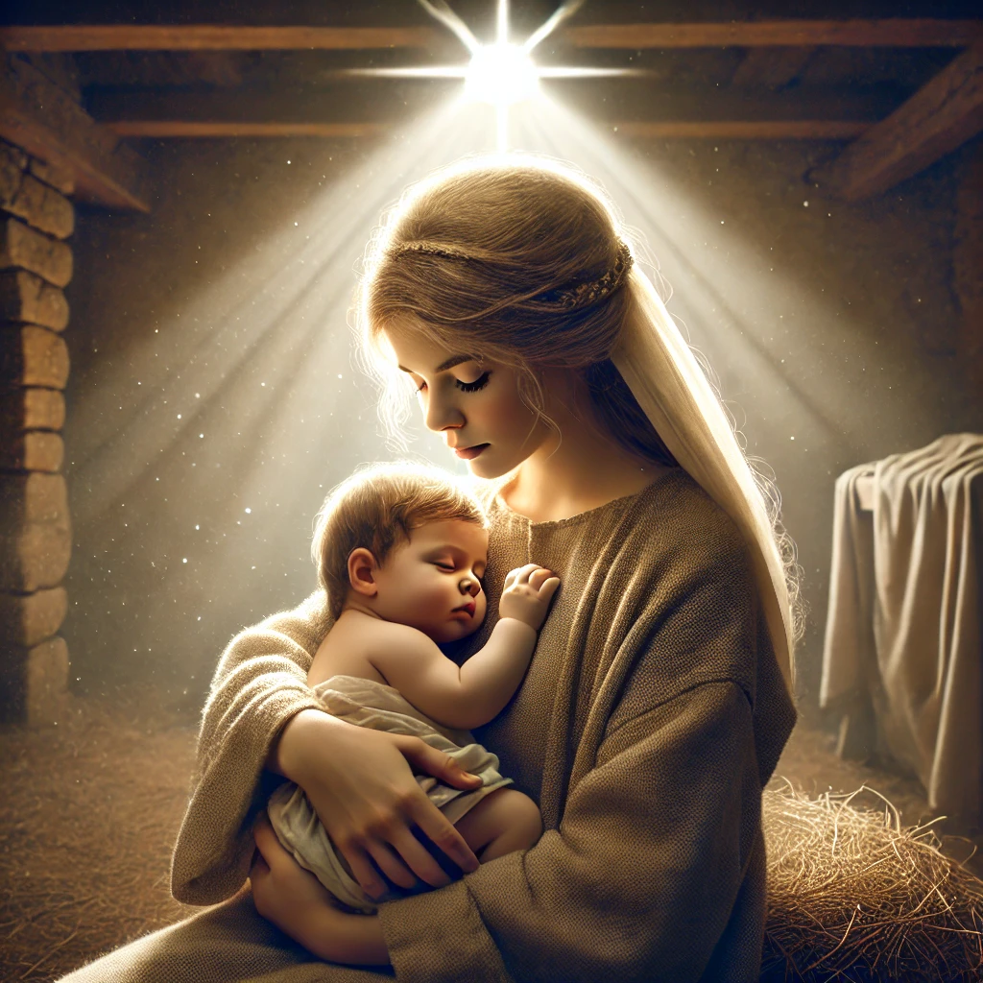
Prophecy Fulfilled
Isaiah 7:14
Matthew 1:20
¹⁴ Therefore the Lord himself shall give you a sign; Behold, a virgin shall conceive, and bear a son, and shall call his name Immanuel.
²⁰ But while he thought on these things, behold, the angel of the Lord appeared unto him in a dream, saying, Joseph, thou son of David, fear not to take unto thee Mary thy wife: for that which is conceived in her is of the Holy Ghost.

Slide 5

Prophecy Fulfilled
Micah 5:2
Matthew 2:1
² But thou, Bethlehem Ephratah, though thou be little among the thousands of Judah, yet out of thee shall he come forth unto me that is to be ruler in Israel; whose goings forth have been from of old, from everlasting.
2 Now when Jesus was born in Bethlehem of Judaea in the days of Herod the king, behold, there came wise men from the east to Jerusalem,

Slide 6
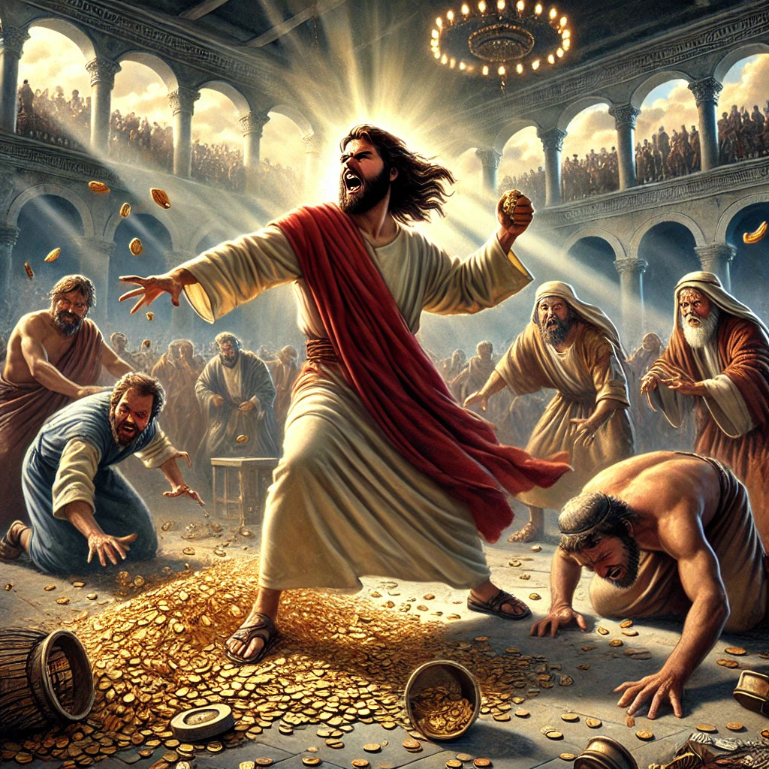
Prophecy Fulfilled
Psalm 69:9
John 2:16-17
⁹ For the zeal of thine house hath eaten me up; and the reproaches of them that reproached thee are fallen upon me.
¹⁶ And said unto them that sold doves, Take these things hence; make not my Father's house an house of merchandise.
¹⁷ And his disciples remembered that it was written, The zeal of thine house hath eaten me up.

Slide 7

Prophecy Fulfilled
Jeremiah 2:13
John 7:38
¹³ For my people have committed two evils; they have forsaken me the fountain of living waters, and hewed them out cisterns, broken cisterns, that can hold no water.
³⁸ He that believeth on me, as the scripture hath said, out of his belly shall flow rivers of living water.

Slide 8
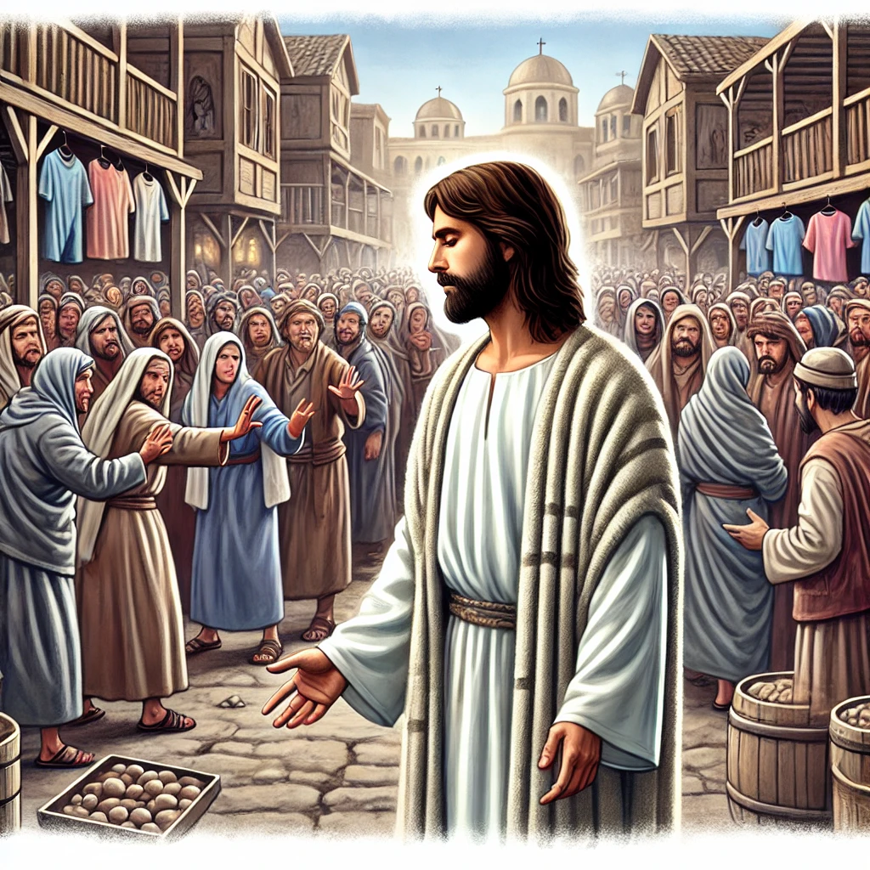
Prophecy Fulfilled
Isaiah 53:3
John 1:10-11
³ He is despised and rejected of men; a man of sorrows, and acquainted with grief: and we hid as it were our faces from him; he was despised, and we esteemed him not.
¹⁰ He was in the world, and the world was made by him, and the world knew him not.
¹¹ He came unto his own, and his own received him not.

Slide 9
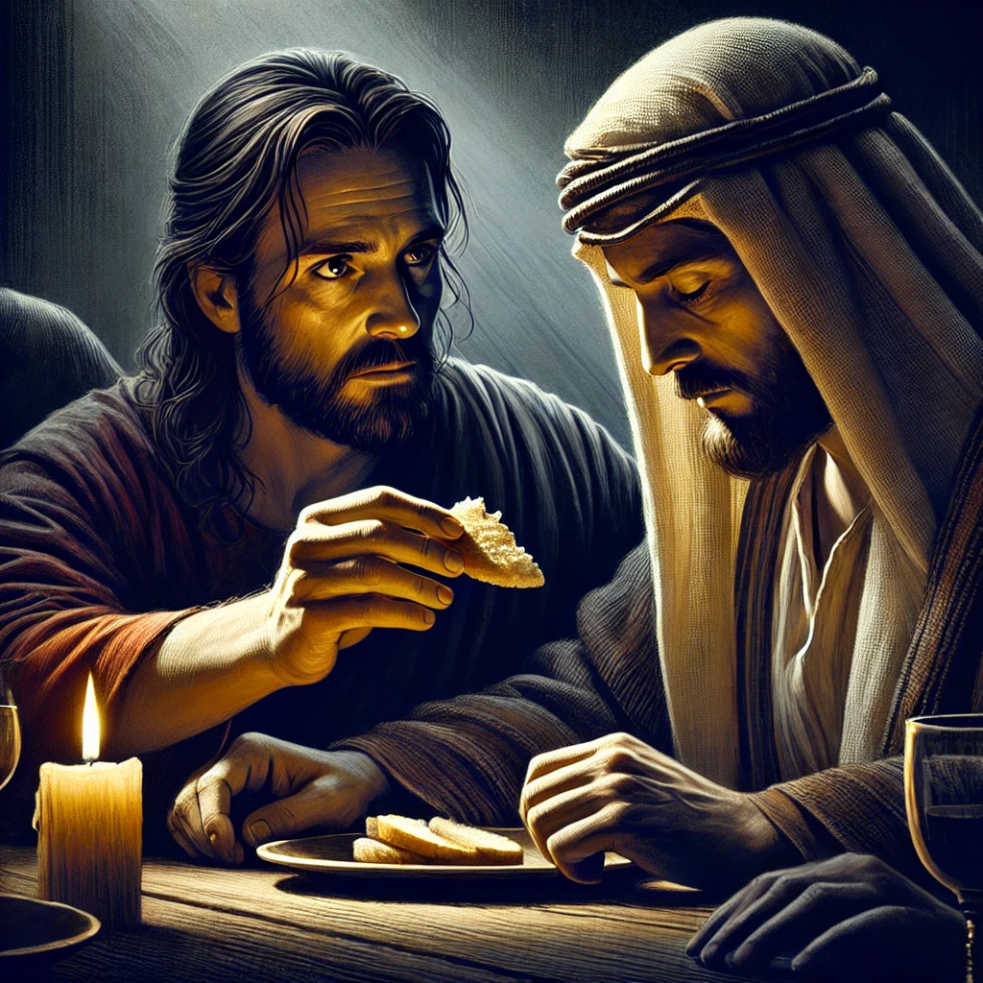
Prophecy Fulfilled
Psalm 41:9
John 13:18
⁹ Yea, mine own familiar friend, in whom I trusted, which did eat of my bread, hath lifted up his heel against me.
¹⁸ I speak not of you all: I know whom I have chosen: but that the scripture may be fulfilled, He that eateth bread with me hath lifted up his heel against me.

Slide 10
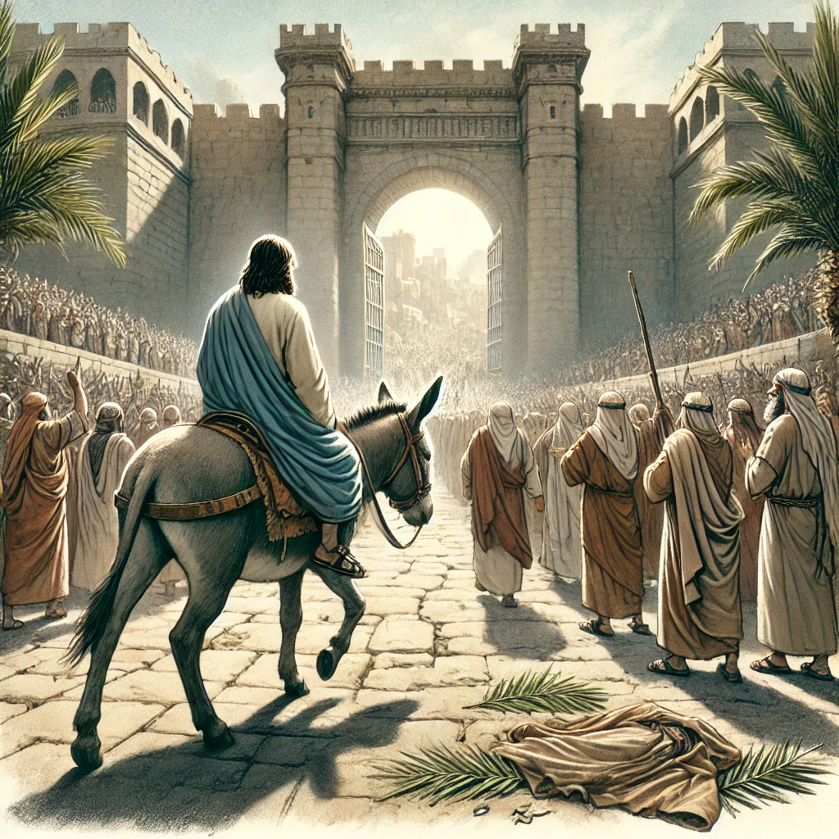
Prophecy Fulfilled
Zecheriah 9:9
John 12:14-15
⁹ Rejoice greatly, O daughter of Zion; shout, O daughter of Jerusalem: behold, thy King cometh unto thee: he is just, and having salvation; lowly, and riding upon an ass, and upon a colt the foal of an ass.
¹⁴ And Jesus, when he had found a young ass, sat thereon; as it is written,
¹⁵ Fear not, daughter of Sion: behold, thy King cometh, sitting on an ass's colt.

Slide 11
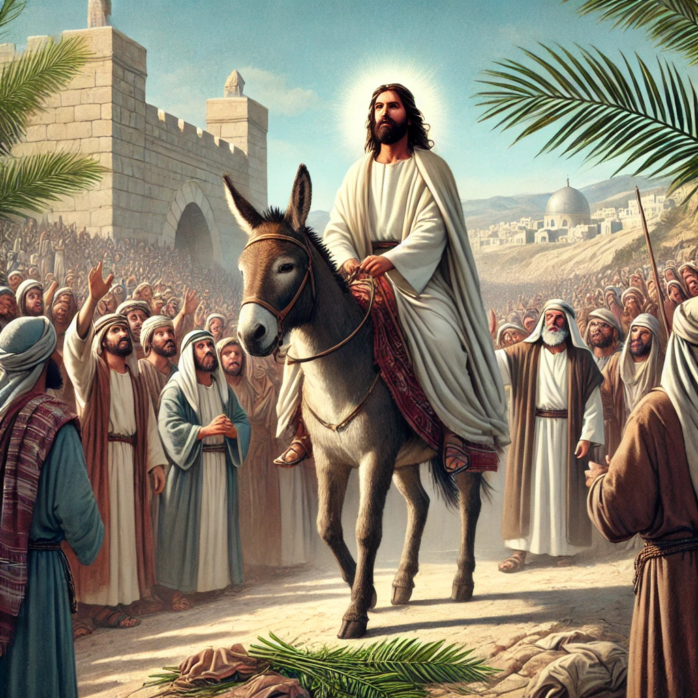
Prophecy Fulfilled
Psalm 118:26
John 12:12-13
²⁶ Blessed be he that cometh in the name of the Lord: we have blessed you out of the house of the Lord.
¹² On the next day much people that were come to the feast, when they heard that Jesus was coming to Jerusalem,
¹³ Took branches of palm trees, and went forth to meet him, and cried, Hosanna: Blessed is the King of Israel that cometh in the name of the Lord.

Slide 12
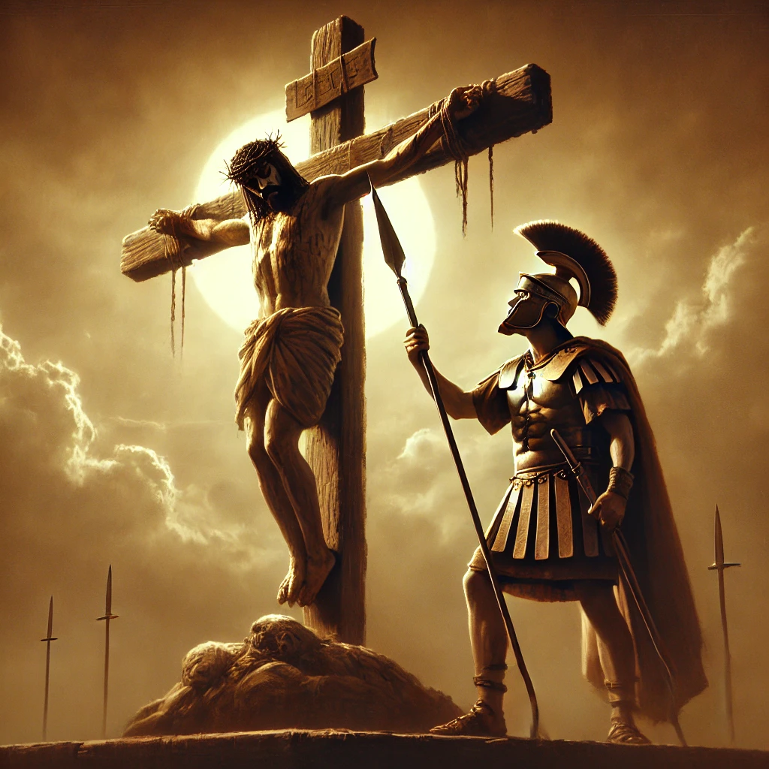
Prophecy Fulfilled
Numbers 9:12
John 19:33-34
¹² They shall leave none of it unto the morning, nor break any bone of it: according to all the ordinances of the passover they shall keep it.
³³ But when they came to Jesus, and saw that he was dead already, they brake not his legs:
³⁴ But one of the soldiers with a spear pierced his side, and forthwith came there out blood and water.

Slide 13
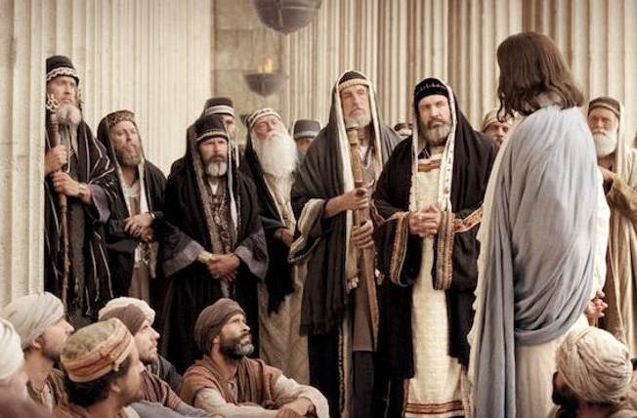
… in your ears
Despite clear fulfillment, many failed to recognize Jesus.

Slide 14

… in your ears
¹⁰ He was in the world, and the world was made by him, and the world knew him not.
John 1:10-12

Slide 15
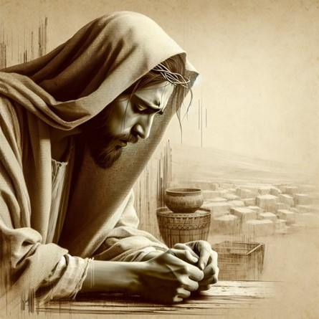
… in your ears
John
1:11
¹¹ He came unto his own, and his own received him not.

Slide 16
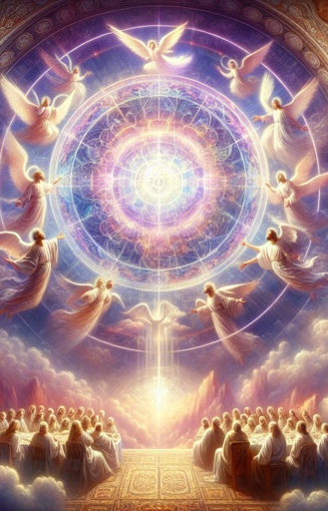
… in your ears
John
1:12
¹² But as many as received him, to them gave he power to become the sons of God, even to them that believe on his name:

Slide 17
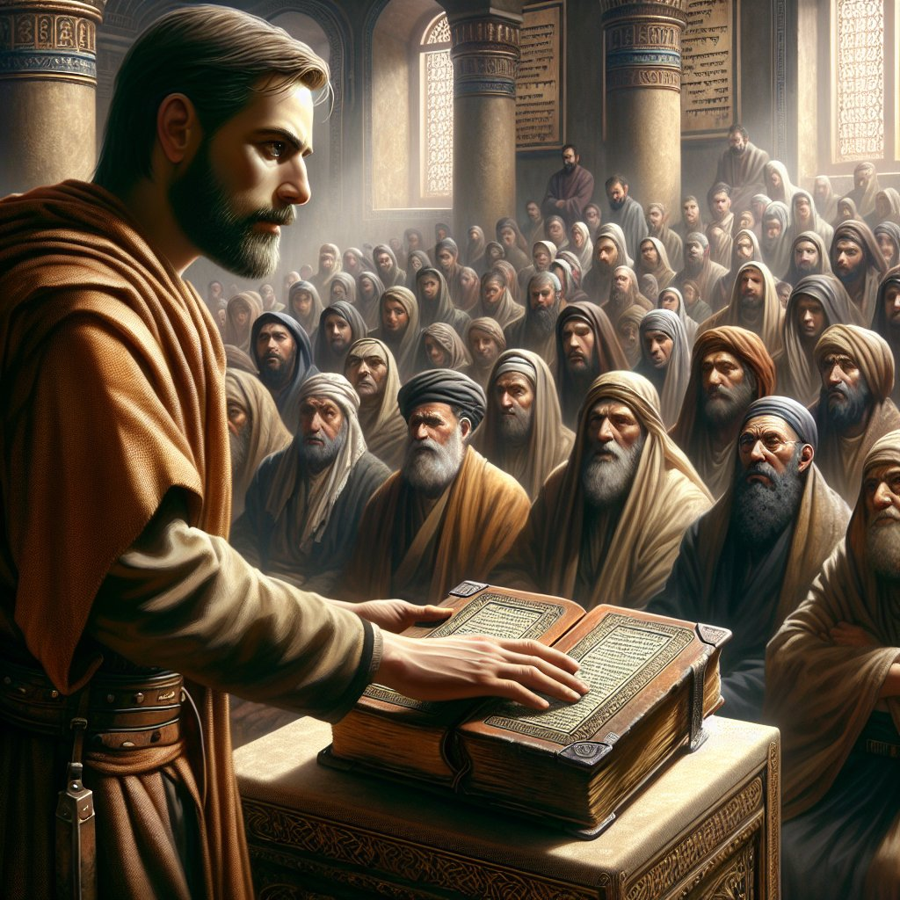
… in your ears
20 And he closed the book, and he gave it again to the minister, and sat down. And the eyes of all them that were in the synagogue were fastened on him.
Luke 4:20-22

Slide 18
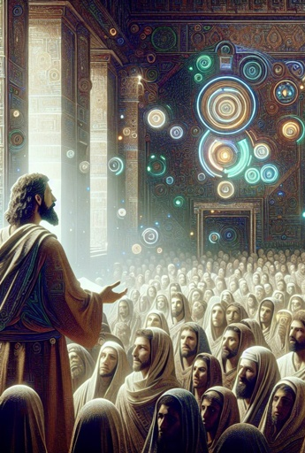
… in your ears
Luke 4:21
21 And he began to say unto them, This day is this scripture fulfilled in your ears.

Slide 19
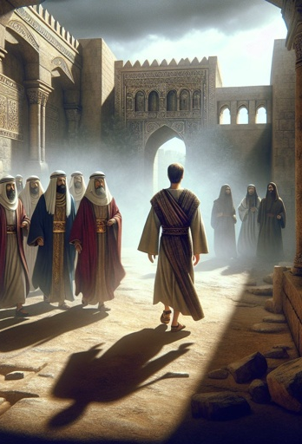
… in your ears
Luke 4:22
22 And all bare him witness, and wondered at the gracious words which proceeded out of his mouth. And they said, Is not this Joseph's son?

Slide 20
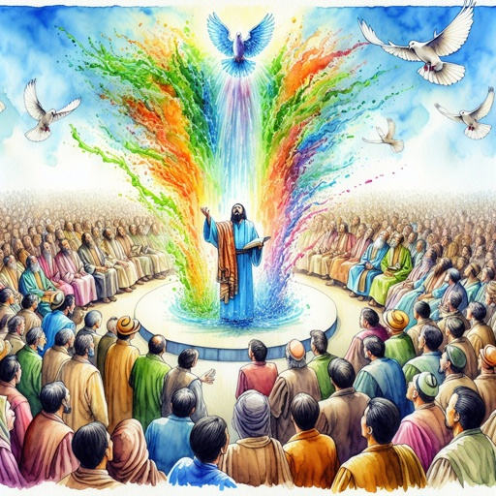
… in your ears
³⁹ Search the scriptures; for in them ye think ye have eternal life: and they are they which testify of me.
⁴⁰ And ye will not come to me, that ye might have life.
John 5:39-40

Slide 21
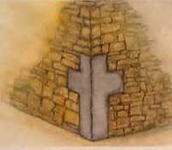
… in your ears
⁴² Jesus saith unto them, Did ye never read in the scriptures, The stone which the builders rejected, the same is become the head of the corner: this is the Lord's doing, and it is marvellous in our eyes?
Matthew 21:42-45

Slide 22
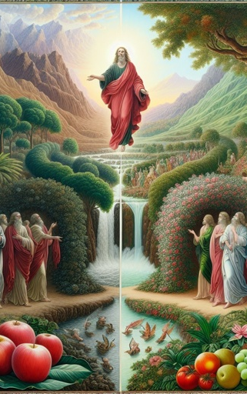
… in your ears
Matthew 21:43
⁴³ Therefore say I unto you, The kingdom of God shall be taken from you, and given to a nation bringing forth the fruits thereof.

Slide 23
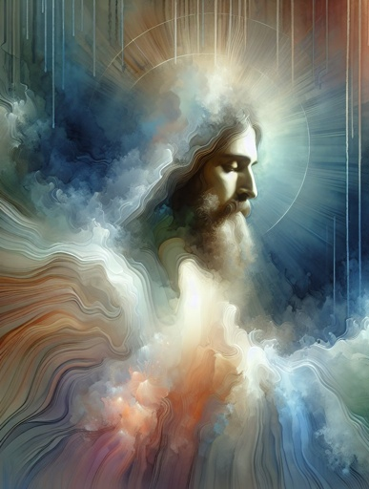
… in your ears
Matthew 21:44
⁴⁴ And whosoever shall fall on this stone shall be broken: but on whomsoever it shall fall, it will grind him to powder.

Slide 24
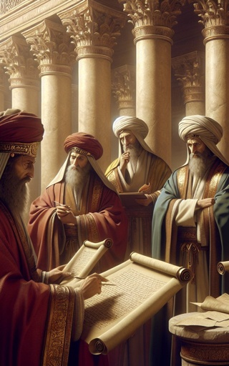
… in your ears
Matthew 21:45
⁴⁵ And when the chief priests and Pharisees had heard his parables, they perceived that he spake of them.

Slide 25
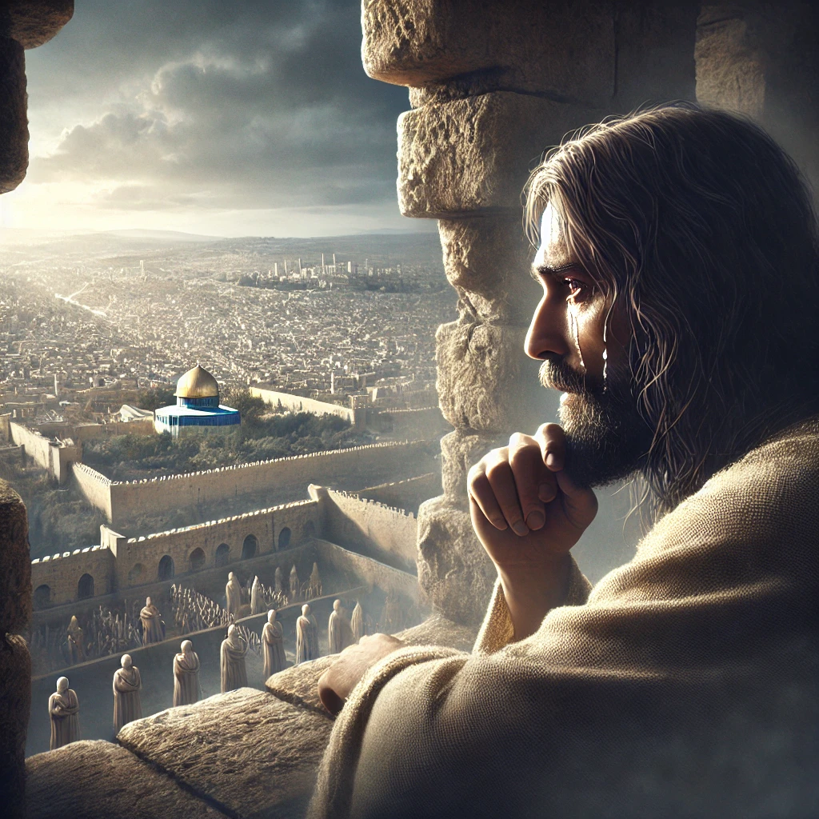
… in your ears
⁴¹ And when he was come near, he beheld the city, and wept over it,
Luke 19:41-44

Slide 26
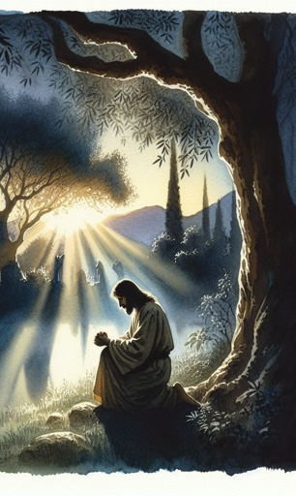
… in your ears
Luke 19:42
⁴² Saying, If thou hadst known, even thou, at least in this thy day, the things which belong unto thy peace! but now they are hid from thine eyes.

Slide 27
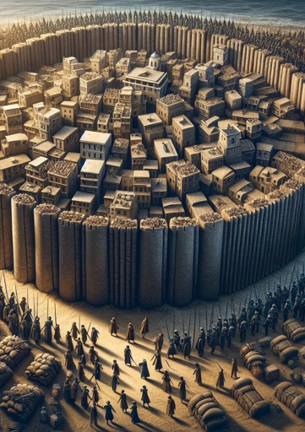
… in your ears
Luke 19:43
⁴³ For the days shall come upon thee, that thine enemies shall cast a trench about thee, and compass thee round, and keep thee in on every side,

Slide 28
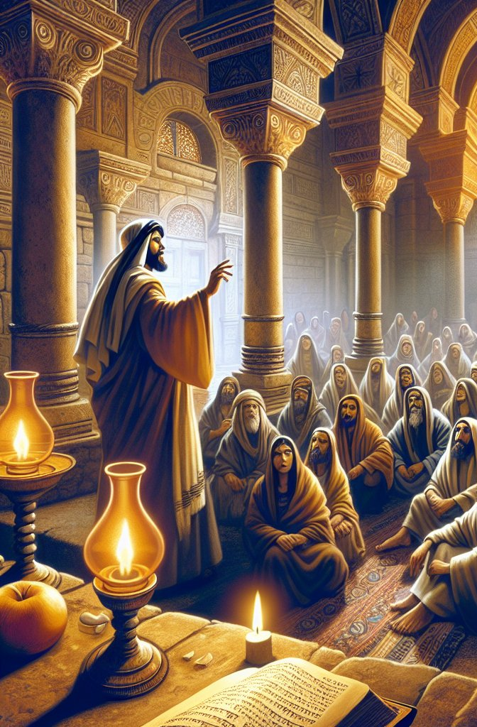
… in your ears
Luke 19:44
⁴⁴ And shall lay thee even with the ground, and thy children within thee; and they shall not leave in thee one stone upon another; because thou knewest not the time of thy visitation.

Slide 29
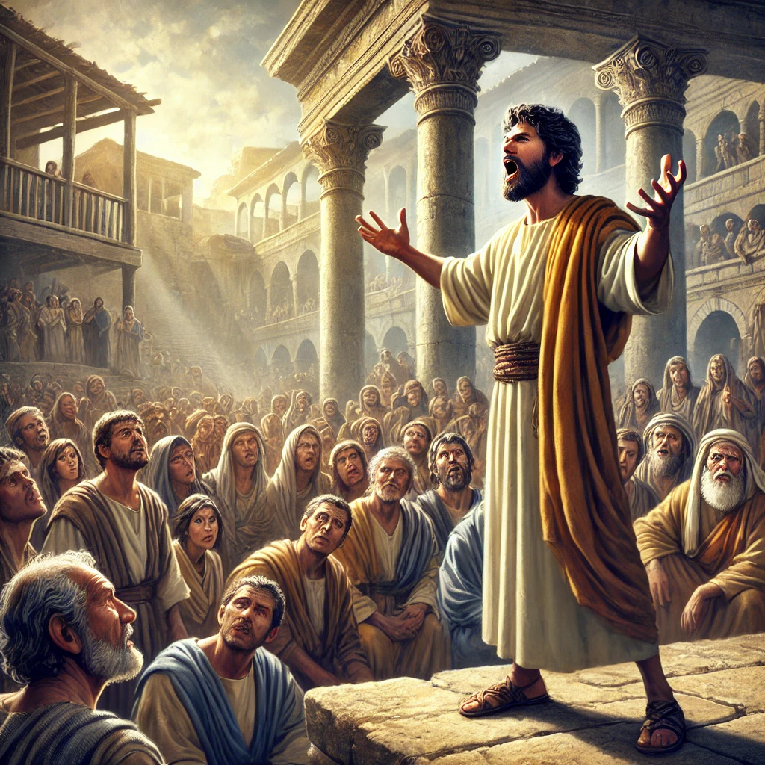
… in your ears
¹⁷ And now, brethren, I wot that through ignorance ye did it, as did also your rulers.
Acts 3:17-19

Slide 30
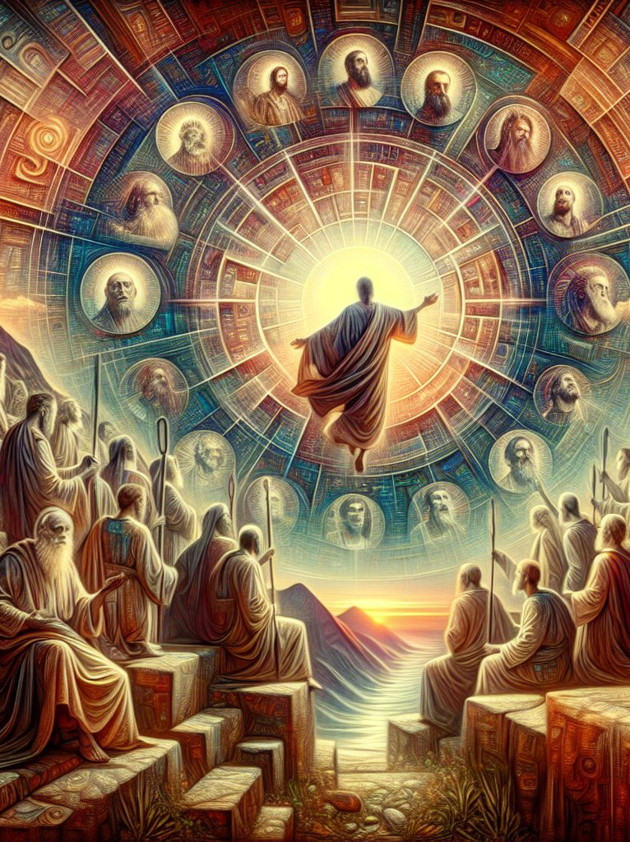
… in your ears
Acts 3:18
¹⁸ But those things, which God before had shewed by the mouth of all his prophets, that Christ should suffer, he hath so fulfilled.

Slide 31
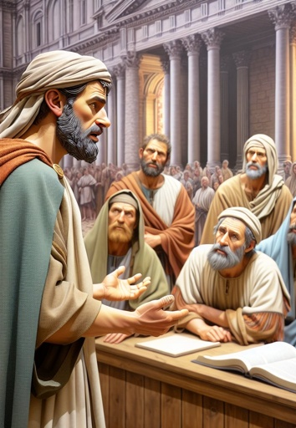
… in your ears
Acts 3:19
¹⁹ Repent ye therefore, and be converted, that your sins may be blotted out, when the times of refreshing shall come from the presence of the Lord.

Slide 32
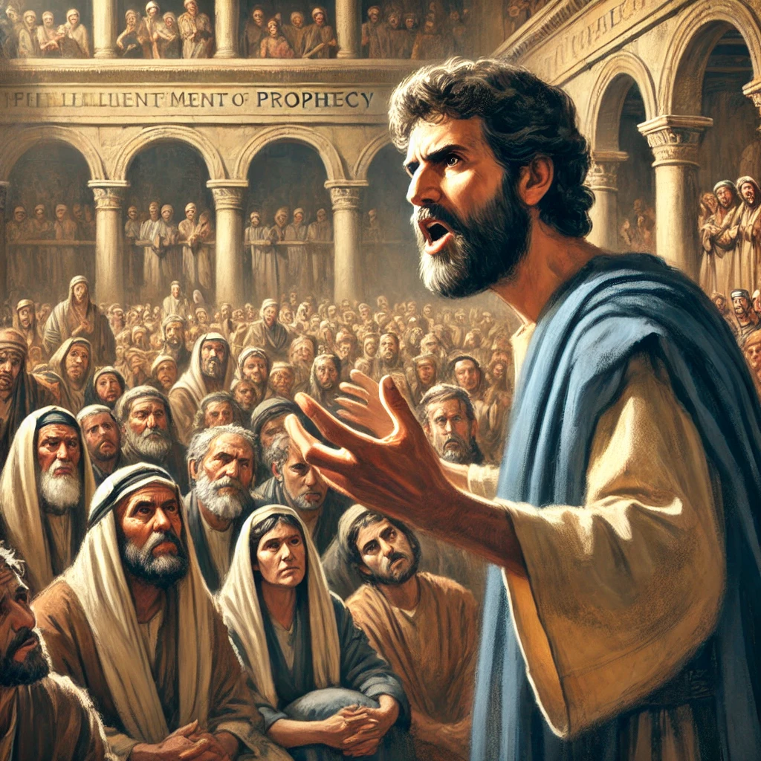
… in your ears
²⁶ Men and brethren, children of the stock of Abraham, and whosoever among you feareth God, to you is the word of this salvation sent.
Acts 13:26-30

Slide 33
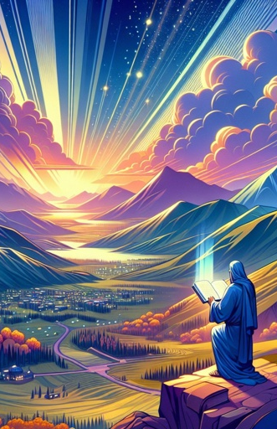
… in your ears
Acts 13:27
²⁷ For they that dwell at Jerusalem, and their rulers, because they knew him not, nor yet the voices of the prophets which are read every sabbath day, they have fulfilled them in condemning him.

Slide 34
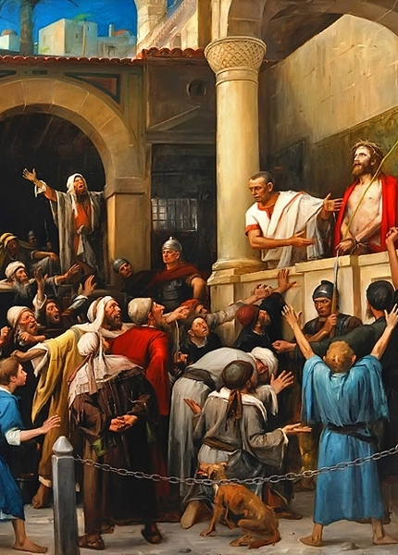
… in your ears
Acts 13:28
²⁸ And though they found no cause of death in him, yet desired they Pilate that he should be slain.

Slide 35
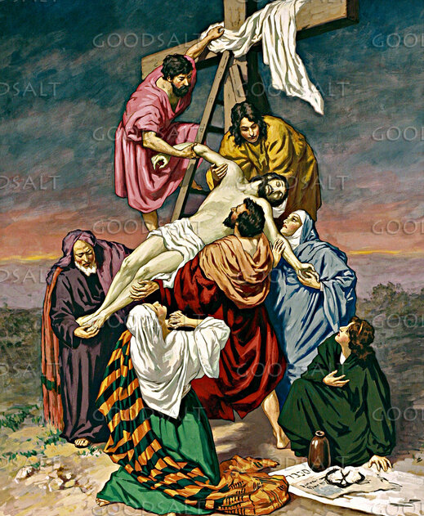
… in your ears
Acts 13:29
²⁹ And when they had fulfilled all that was written of him, they took him down from the tree, and laid him in a sepulchre.

Slide 36
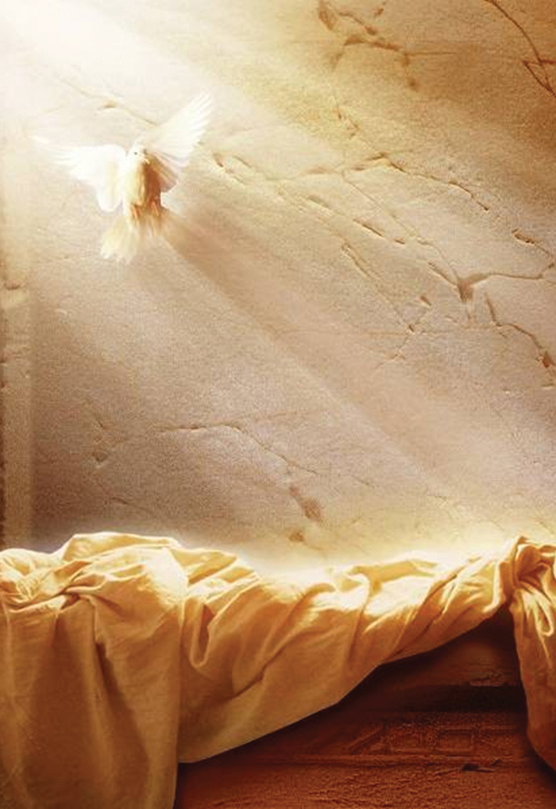
… in your ears
Acts 13:30
³⁰ But God raised him from the dead:

Slide 37
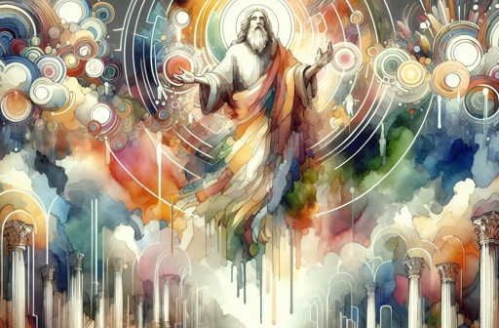
Discernment:
John 8:12-30
Jesus confronts the Pharisees about their failure of discernment.

Slide 38
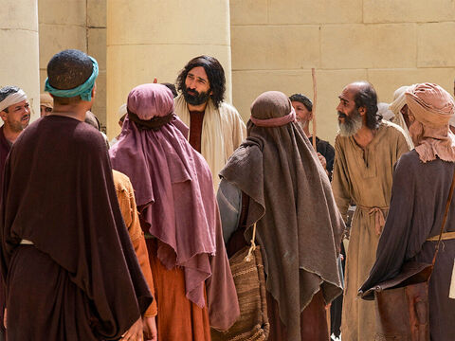
Discernment:
John 8:12
¹² Then spake Jesus again unto them, saying, I am the light of the world: he that followeth me shall not walk in darkness, but shall have the light of life.

Slide 39
Discernment:
In one of their commentaries on the book of Exodus the Jews represent the words of the Torah (Law) as illuminating the one who engaged in their study. Concerning the one not engaged in their study or ignorant of them the comment says:“ He stumbles against a stone; he then strikes a gutter, falls into it, and knocks his face on the ground — and all because he has no lamp in his hand. It is the same with the ordinary individual who has no Torah in him; he strikes against sin, stumbles, and dies” (Midrash Rabbah, on Ex. 27:20, Soncino ed., p. 439).
Light
(SDABC)

Slide 40
Discernment:
The Jews had One standing in their midst who was greater than the Torah, for He Himself had given them the Torah. He was the source of the light in the Torah (see PP 366). But the rabbis had so obscured that light with their traditions that he who attempted to walk in the light of the Torah as interpreted by the rabbis was in reality walking in darkness.
Light
(SDABC)

Slide 41
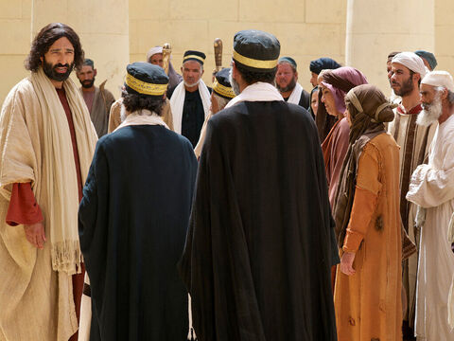
Discernment:
John 8:13
¹³ The Pharisees therefore said unto him, Thou bearest record of thyself; thy record is not true.

Slide 42
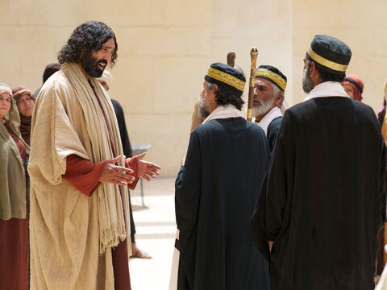
Discernment:
John 8:14
¹⁴ Jesus answered and said unto them, Though I bear record of myself, yet my record is true: for I know whence I came, and whither I go; but ye cannot tell whence I come, and whither I go.

Slide 43
Discernment:
John 8:15-16
¹⁵ Ye judge after the flesh; I judge no man.
¹⁶ And yet if I judge, my judgment is true: for I am not alone, but I and the Father that sent me.

Slide 44
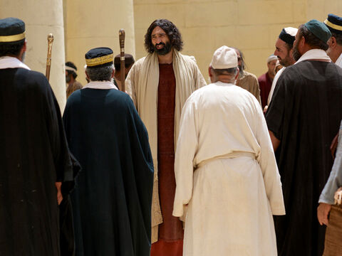
Discernment:
John 8:17-18
¹⁷ It is also written in your law, that the testimony of two men is true.
¹⁸ I am one that bear witness of myself, and the Father that sent me beareth witness of me.

Slide 45
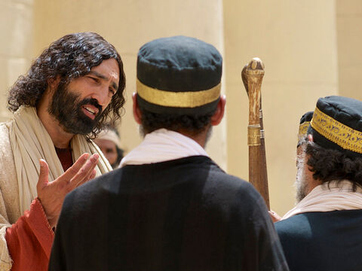
Discernment:
John 8:19
¹⁹ Then said they unto him, Where is thy Father? Jesus answered, Ye neither know me, nor my Father: if ye had known me, ye should have known my Father also.

Slide 46
Discernment:
John 8:20
²⁰ These words spake Jesus in the treasury, as he taught in the temple: and no man laid hands on him; for his hour was not yet come.

Slide 47
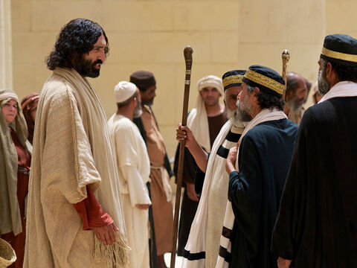
Discernment:
John 8:21
²¹ Then said Jesus again unto them, I go my way, and ye shall seek me, and shall die in your sins: whither I go, ye cannot come.

Slide 48
Discernment:
John 8:22
²² Then said the Jews, Will he kill himself? because he saith, Whither I go, ye cannot come.

Slide 49
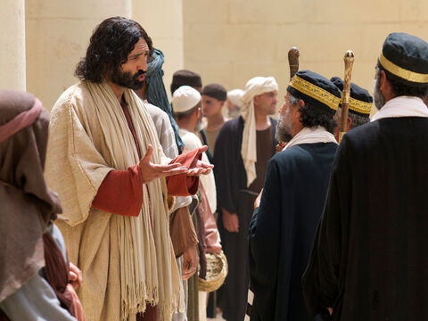
Discernment:
John 8:23
²³ And he said unto them, Ye are from beneath; I am from above: ye are of this world; I am not of this world.

Slide 50
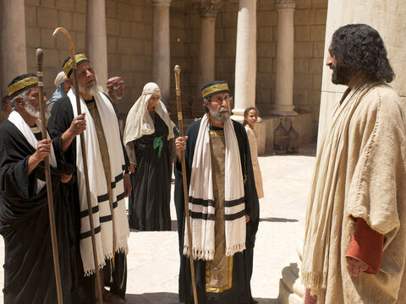
Discernment:
John 8:24
²⁴ I said therefore unto you, that ye shall die in your sins: for if ye believe not that I am he, ye shall die in your sins.

Slide 51
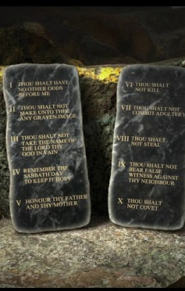
Discernment
Hosea 4:6
⁶ My people are destroyed for lack of knowledge: because thou hast rejected knowledge, I will also reject thee, that thou shalt be no priest to me: seeing thou hast forgotten the law of thy God, I will also forget thy children.

Slide 52
Discernment:
The particular knowledge that is missing is the knowledge of God, the most essential of all knowledge. Though God may overlook certain forms of ignorance (see Acts 17:30), He cannot deliberate ignorance of spiritual things. The people would inevitably be “destroyed” because of their lack of the essential knowledge. They might have had the knowledge had they put forth the effort to obtain it.
Knowledge
(SDABC)

Slide 53
Discernment:
Men are held responsible not only for what they know, but also for what they might have known had they put forth the effort to obtain essential knowledge. There are many who fear that a further investigation of truth will reveal that a change in conduct may be required of them, a change that their sin-loving hearts are unwilling to undertake, and so they deliberately desist from further inquiry. Such willful ignorance God cannot excuse.
Knowledge
(SDABC)

Slide 54
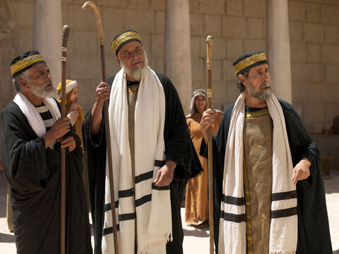
Discernment:
John 8:25
²⁵ Then said they unto him, Who art thou? And Jesus saith unto them, Even the same that I said unto you from the beginning.

Slide 55
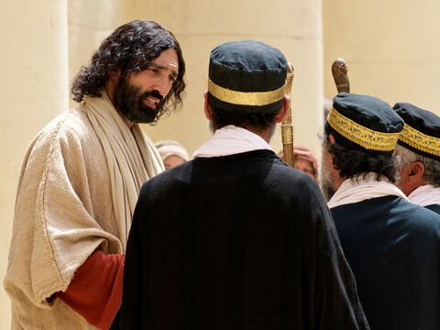
Discernment:
John 8:26-27
²⁶ I have many things to say and to judge of you: but he that sent me is true; and I speak to the world those things which I have heard of him.
²⁷ They understood not that he spake to them of the Father.

Slide 56
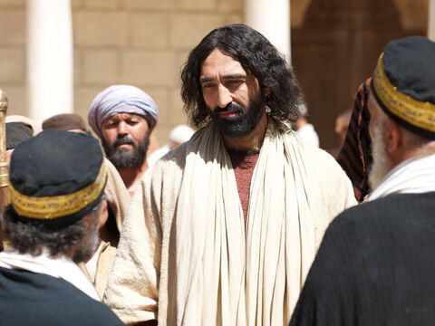
Discernment:
John 8:28
²⁸ Then said Jesus unto them, When ye have lifted up the Son of man, then shall ye know that I am he, and that I do nothing of myself; but as my Father hath taught me, I speak these things.

Slide 57
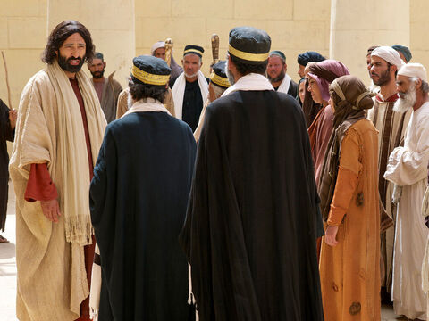
Discernment:
John 8:29-30
²⁹ And he that sent me is with me: the Father hath not left me alone; for I do always those things that please him.
³⁰ As he spake these words, many believed on him.

Slide 58

Discernment
1 Corinthians 2:13-15
¹³ Which things also we speak, not in the words which man's wisdom teacheth, but which the Holy Ghost teacheth; comparing spiritual things with spiritual.

Slide 59
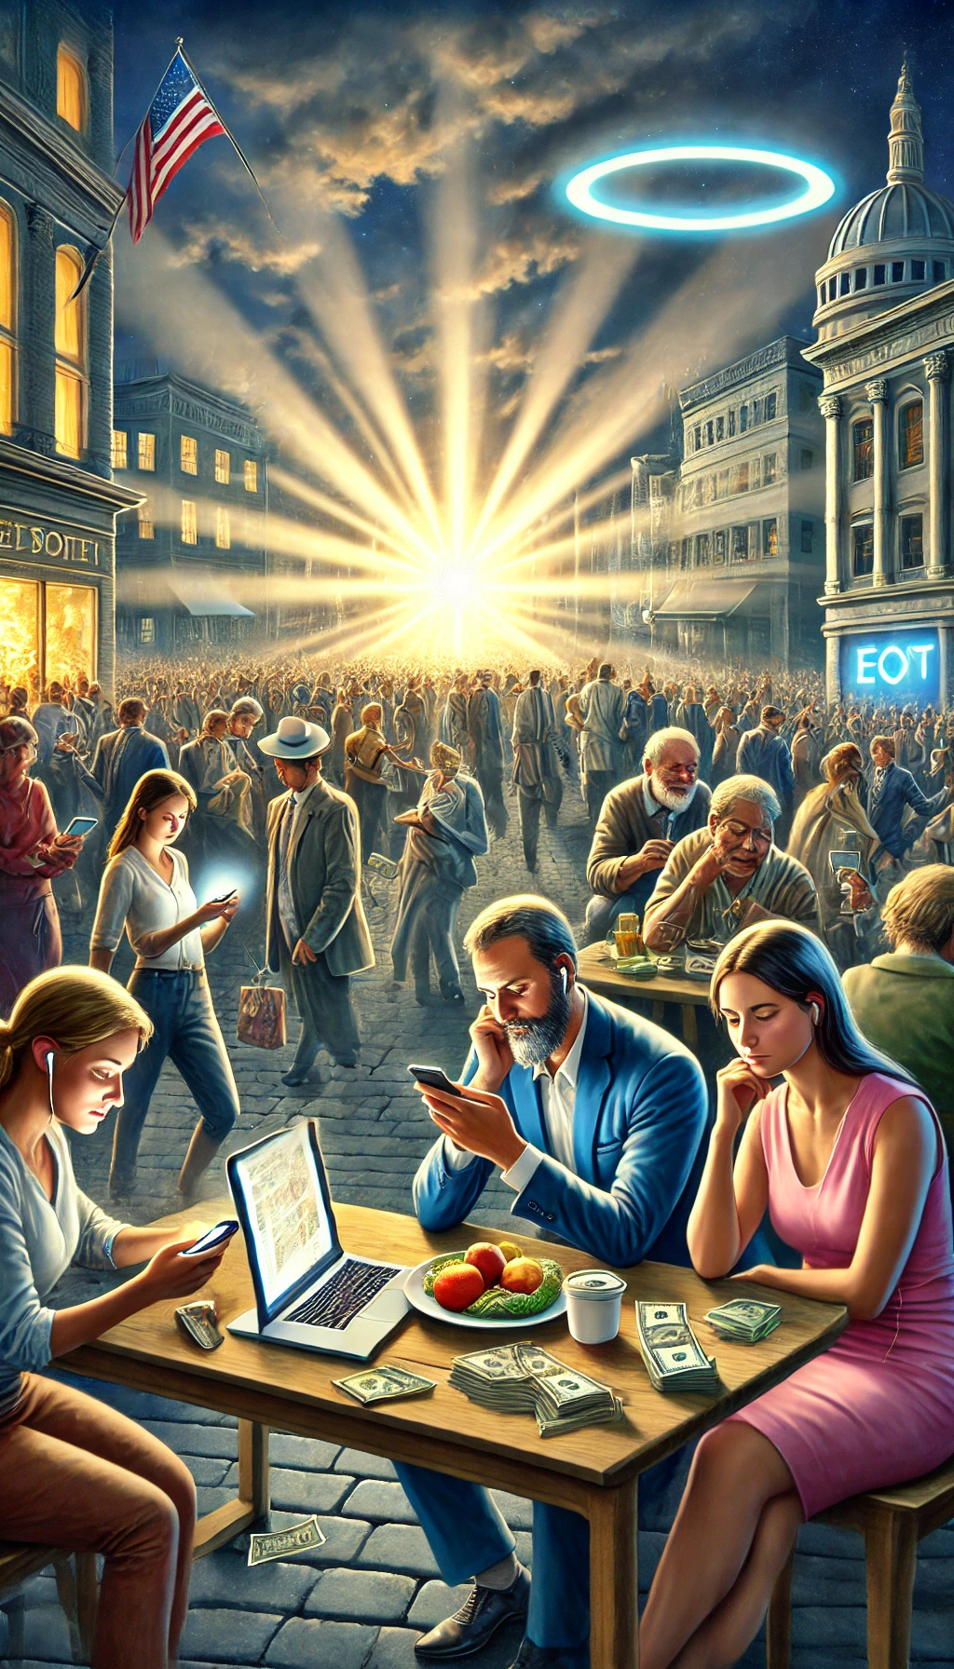
Discernment
1 Corinthians 2:14-15
¹⁴ But the natural man receiveth not the things of the Spirit of God: for they are foolishness unto him: neither can he know them, because they are spiritually discerned.

Slide 60

Discernment
1 Corinthians 2:15
¹⁵ But he that is spiritual judgeth all things, yet he himself is judged of no man.

Slide 61
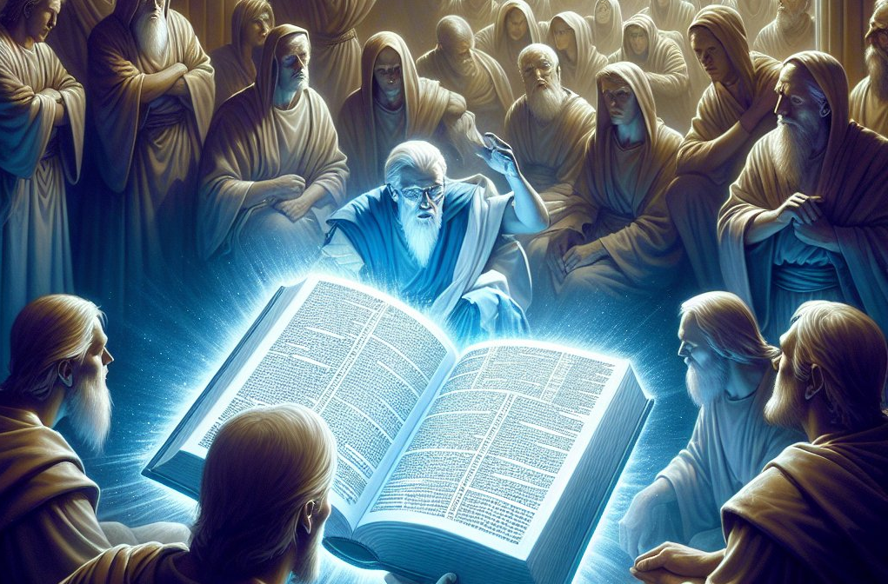
The Prophets
Can we do better?

Slide 62
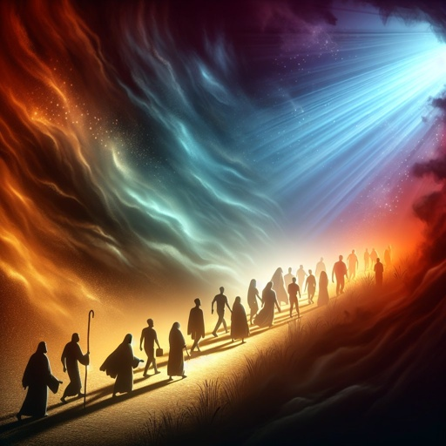
The Prophets: John 12:35-41
³⁵ Then Jesus said unto them, Yet a little while is the light with you. Walk while ye have the light, lest darkness come upon you: for he that walketh in darkness knoweth not whither he goeth.

Slide 63
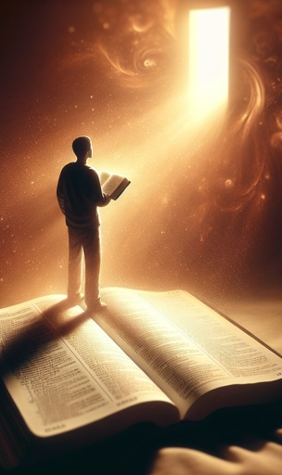
The Prophets
John 12:36-41
³⁶ While ye have light, believe in the light, that ye may be the children of light. These things spake Jesus, and departed, and did hide himself from them.

Slide 64

The Prophets
John 12:37-41
³⁷ But though he had done so many miracles before them, yet they believed not on him:

Slide 65

The Prophets
John 12:38-41
³⁸ That the saying of Esaias the prophet might be fulfilled, which he spake, Lord, who hath believed our report? and to whom hath the arm of the Lord been revealed?

Slide 66

The Prophets
John 12:39-41
³⁹ Therefore they could not believe, because that Esaias said again,

Slide 67

The Prophets
John 12:40-41
⁴⁰ He hath blinded their eyes, and hardened their heart; that they should not see with their eyes, nor understand with their heart, and be converted, and I should heal them.

Slide 68

The Prophets
John 12:41
⁴¹ These things said Esaias, when he saw his glory, and spake of him.

Slide 69

The Prophets: 2 Peter 1:19
¹⁹ We have also a more sure word of prophecy; whereunto ye do well that ye take heed, as unto a light that shineth in a dark place, until the day dawn, and the day star arise in your hearts:

Slide 70

The Prophets: Matthew 24:42, 44
⁴² Watch therefore: for ye know not what hour your Lord doth come…
⁴⁴ Therefore be ye also ready: for in such an hour as ye think not the Son of man cometh.

Slide 71

The Prophets: John 8:31-32
³¹ Then said Jesus to those Jews which believed on him, If ye continue in my word, then are ye my disciples indeed;
³² And ye shall know the truth, and the truth shall make you free.

Slide 72

Thanks!
Have a happy Sabbath!

